Slide 1

Deus Ex bach-ina
Generating music in the style of the Well-Tempered Clavier
Notes:
Welcome to Deus Ex Bach-ina! I taught a Recurrent Neural Network built with Tensorflow to create new sequences of notes using the style of Bach’s Well-Tempered Clavier as the training input.

Slide 2
About me
Musician of 19 years
A.S. in Music Technology
Interested in the blend of art and science
Notes:
As a musician of 19 years, I’ve grown to appreciate how music is a beautiful abstraction of numbers and math

Slide 3
Contents
Historical Background
Approach
The Model
Looking Forward

Slide 4

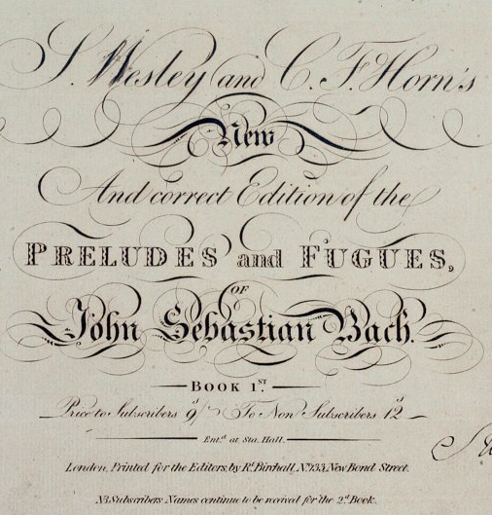
The Well-Tempered Clavier
Collection of 24 Preludes and Fugues
Covers every musical key, major and minor
Credited with popularizing equal temperament
This Photo by Unknown Author is licensed under CC BY-SA
Notes:
I opted for WTC because it covered the breadth of all key combinations in Western music, is a popular and broadly available collection, and has been heavily researched for its influence in keyboard music.

Slide 5


Musical Instrument Digital Interface
What is MIDI?
Digital representation of a musical performance
Standardizes and numericizes:
Instrument played
Pitch
Dynamics
And much more
Keyboard instruments make for good ‘on/off’ signals
Notes:
With MIDI, the audio data is no longer represented by a sin frequency but a single absolute value, i.e. A could be 31, 43, 55, etc.
Makes it easier to feed into a machine – it’s already a numerical representation
How to handle notes appearing together or separately, silence(?!), what happens with key changes

Slide 6
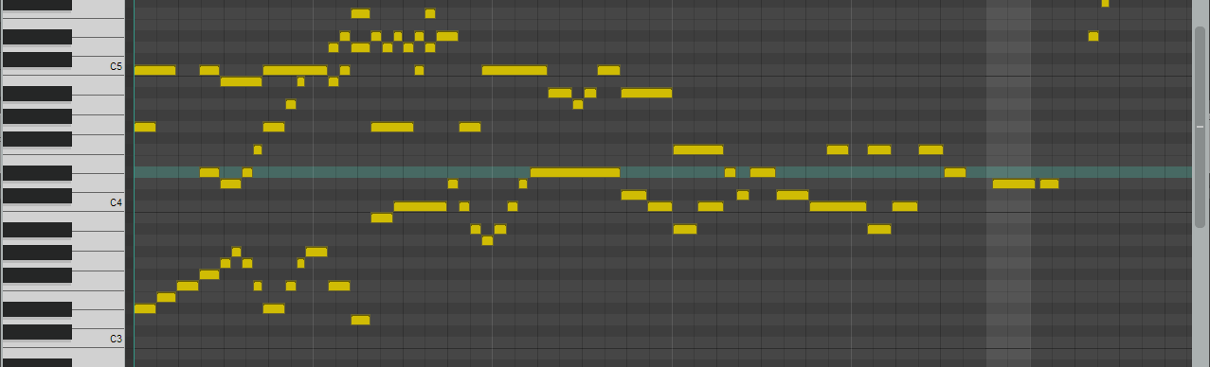
Processing the Data
Using PyPianoRoll, convert to 1D NumPy array
The MIDI does not maintain tempo or dynamics
The keys are ‘on/off’ values, so always 88 values of 0 or 1
Notes:
X-axis = Time
Y-axis = Binary notes

Slide 7
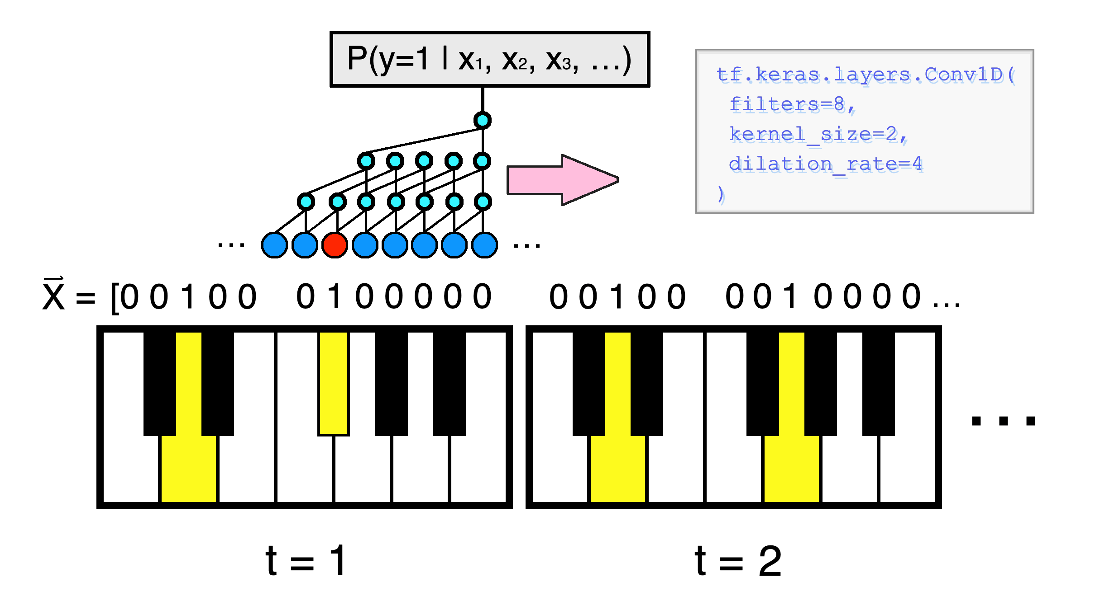
The Model
WaveNet-based Recurrent Neural Network
Predict the subsequent note given one to start on
As note sequences, intervals are respected
Notes:
As the model receives input, it estimates the subsequent note and measures its distance from the true note in the composition.
The idea is that the model could be close enough to a human that it could estimate a note correctly enough to build off itself
Our input is a sequence of 0s and 1s, and measures the probability of a note being turned on given the other notes that are turned on at a point in time.

Slide 8

Training The model
2 sets of 16 Convolutional Layers increasing Dilation Rate
Trained for ~1600 Epochs
Measured loss – Binary Crossentropy
Notes:
2 ‘blocks’ of Conv1Ds,

Slide 9
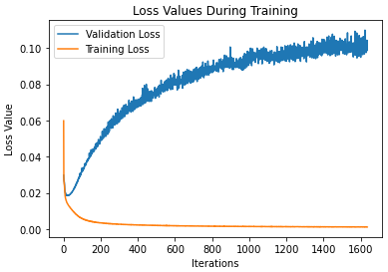
Loss Values

Slide 10
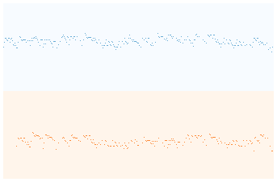

The first Performance (100 Epochs)

Slide 11

Performance after 1600 Epochs
Notes:
Example Song

Slide 12
Future Development
-Online learning
-’Recover’ when the model loses direction
Notes:
While these would be novel additions to the model’s structure, the likely best addition is just to beef up the model, increasing its layer count and respective dilation rate while providing even greater amounts of time.
Changing the input more may have been more robust: rather than one movement per key, have every movement performed in every key to reduce chance that a sequence is learned by a particular key.

Slide 13










And these creators without logos:
Pygame
Pypianoroll
Thomas Angsten

Slide 14

Connect with me!
Joseph.Aylsworth@gmail.com
linkedin.com/in/joseph-aylsworth
github.com/Satch7320
Notes:
2 ‘blocks’ of Conv1Ds,

